Slide 1




WELCOME
Smart Safety Helmet Presentation
scope
history
timeline
Why
DESIGNED BY Fourth Year Graduation Team
Project supervisor : DR / Walaa Mohamed
Assistant Supervisor : DR / Shimaa Sami

Slide 2
WORKING TEAM
scope
history
timeline
Why
Mohamed Ahmed Abd Elghany
Rahma Mohamed Ebrahim Salem
Mohamed Ahmed Asker
Habiba Essam Mohamed Abd Eldayem
Amr Sabri Abd Elmoneim Amr
Alaa Mohamed Abdelsatar Elattar
Fatma Hosafi Ibrahim Ageba

Slide 3
Occupational Safety and Health Administration
It's a U.S. federal agency under the Department of Labor that was created in 1970 . Its main mission is to ensure safe and healthy working conditions for all American workers by setting and enforcing standards, providing training, outreach, education, and assistance.
2014
2017
2018
2021
1
2
3
4
scope
history
timeline
Why
60,000 Accident round World
Budget
Falls
Injuries
The Budget Of Occupational Safety and Health Administration in USA Reached More Than $550,000,000
338 out of 1,008 total deaths in construction (33.5%)
2.6 million reported non-fatal workplace injuries in the private sector in 2021
That is a rate of 3.3 accident per 100,000 full-time employed workers

Slide 4
Statistics Of Common Work Sites Hazards
scope
history
timeline
Why

Slide 5
Why We Choose This Idea ?
history
scope
WHY
timeline
1) To reduce the risk of injury while working on construction sites.
2) To save effort and time.
3) Increase control over workers and increase performance further.
4) Protect workers and avoid the risk of injury while performing their jobs
5) The possibility of following construction work through the phone application or website.

Slide 6
scope
timeline
history
Why
OCT 2023
DEC 2023
JAN 2024
FEB 2024
Getting ready
Documentations
Implementation
Implementation
We started to develop our skills to reach the required point that we need to implement the project
We started building our project documentations such as presentation & ERD model & use case model
We started implementing the project as we planned
We finished implementing website and mobile app as we planned

Slide 7



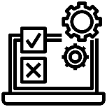
WebSite
Mobile App
We designed a responsive website with smooth and simple interface to ease using for supervisors or monitor.
We designed a mobile application for supervisors and managers in case their labtops are not available to use they can use this app.
Sensors
Connection
history
Scope
Starting programming sensors to make every sensor do its job and collecting data from these sensors .
Making connections between the sensors & microcontroller to collect data and send this data to the server
timeline
Why
Testing
Here we needed to test the project and increasing the performance of sensors to get highest accuracy rate.

Slide 8
Introduction:
The project falls within the realm of wearable technology and IOT devices in the construction industry. It combines elements of sensor technology, real-time data analysis, and communication systems to enhance worker safety and efficiency on construction sites.
Project Timeline: The project will be executed in several phases, with an estimated timeline as follows:
Phase 1: Requirement analysis and concept design (2 months)
Phase 2: Hardware and software development (4 months)
Phase 3: Integration and testing (1 months)
Phase 4: Documentation, training, and finalization (1 month)
Scope
history
timeline
Why
Features and Functionality:
The smart safety helmet will include the following features and functionality:
- Impact detection: Sensors to detect impacts and collisions, triggering immediate alerts.
- Hazard monitoring: Sensors to monitor environmental factors such as temperature, humidity, and air quality.
- Fall detection: Accelerometers and gyroscopes to detect falls and initiate emergency protocols.

Slide 9
Features and Functionality:
- GPS tracking: Integration of GPS technology to locate and track helmet wearers in real-time. - Alert and notification system: Visual, auditory, and haptic alerts to warn the wearer and relevant personnel of potential dangers.
- Data logging and analysis: Capture and store data for future analysis and reporting.
- User interface: An intuitive interface for configuring settings, accessing data, and managing the helmet's functionalities.
Deliverables:
The project will deliver the following outcomes:
- Fully functional smart safety helmet prototype with all the specified features.
- User documentation and guidelines for operating and maintaining the helmet.
- Software applications for data analysis, configuration, and management.
- Testing and validation reports to ensure its reliability and compliance with safety standards.
- Training materials for end-users to understand the features and benefits of the smart safety helmet.
Scope
history
timeline
Why

Slide 10
Smart Helmet
1
Object Detection
2
Gas Monitoring
functions
3
Temperature & Humidity Monitoring
4
GPS Tracking
5
Fall Detection

Slide 11
Object Detection
Gas Monitoring
How Does It Work:
Liquefied Petroleum Gas (LPG)
-Transmitter Sends an original signal in the range from 2 – 400 cm. if there is an object in that range , the signal will be reflected and the sensor receives it through the Receiver .
- In that moment , This range will be the distance between the object and the sensor.(the helmet)
* As per to OSHA the normal average of LPG is 1000 ppm .
More than 180,000 GAS LEAKS.
No
If g > 1000
Alert
End
About 3020 Fires & Explosions.
yes
yes
If 2<D<400
Carbon Monoxide (CO)
No
Alert
* As per to OSHA the normal average of CO is 50 ppm .
About 50,000 GAS LEAKS.
End
No
430 Fatalities.
If c > 50
Alert
End
yes

Slide 12
Temperature & Humidity Monitoring
GPS Tracking
* As per to OSHA , Humidity in workplace can be controlled between 20% and 60% .
How Does It Work:
helmet has tracking sensor so supervisor can see workers location on google maps throw the website or mobile app to know where they are if he needed any of them .
How Does It Work:
If the humidity is out of the mentioned range , helmet will send an alert to the system so supervisor will make arrangements to avoid any injuries .
No
yes
If status = on
track
End
yes
If 20% <h < 60%
Alert
End
No
Fall Detection
No
How Does It Work:
helmet has drop detection sensor that detect any fall and send alert to system so supervisor will be contacted if one of workers fall
If Drop
Alert
End
yes

Slide 13
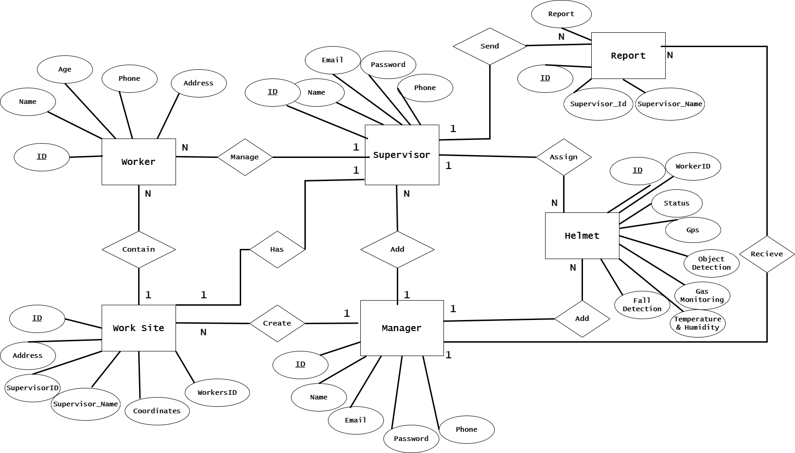
Structural diagrams
. ERD diagram

Slide 14
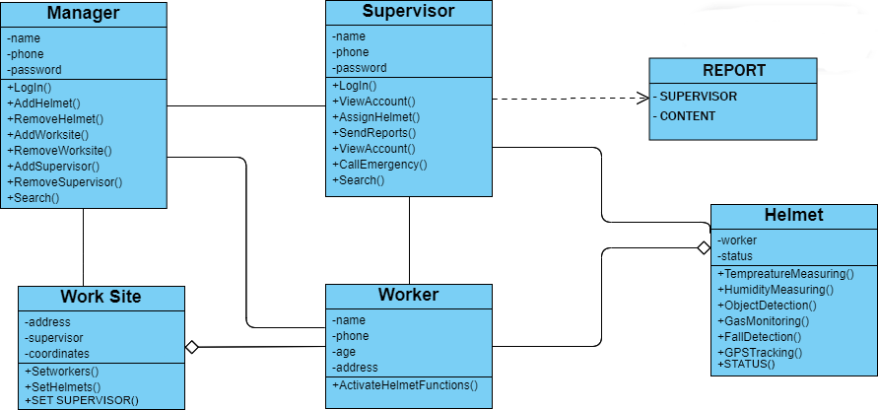
Structural diagrams
. Class diagram

Slide 15
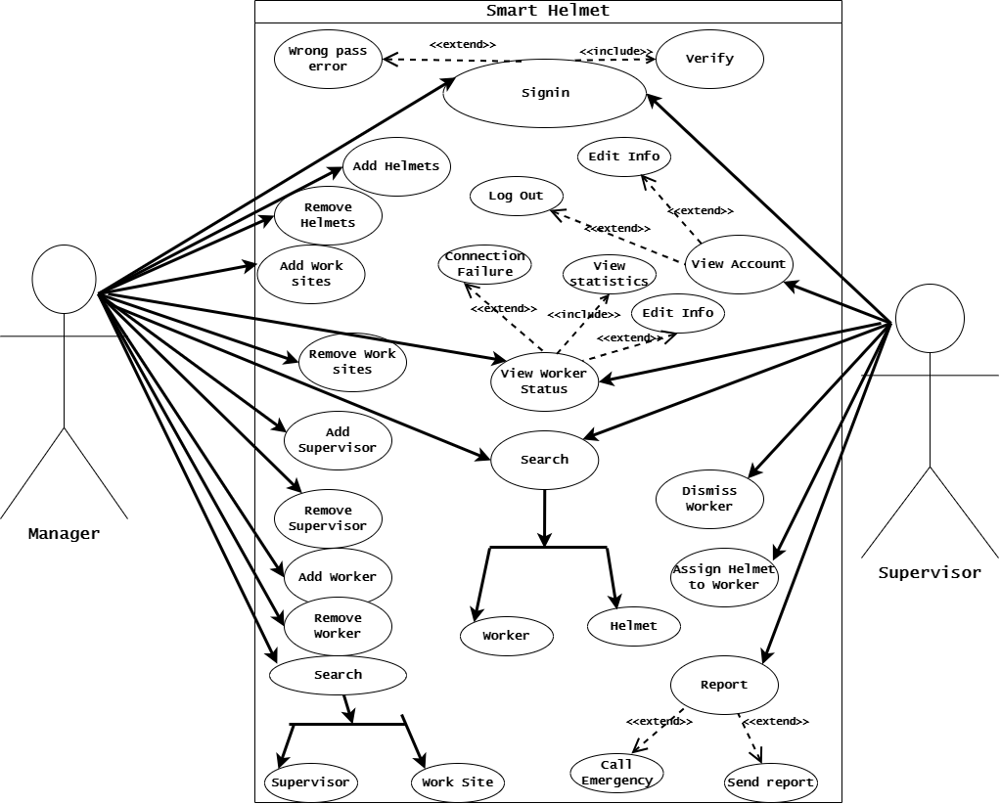
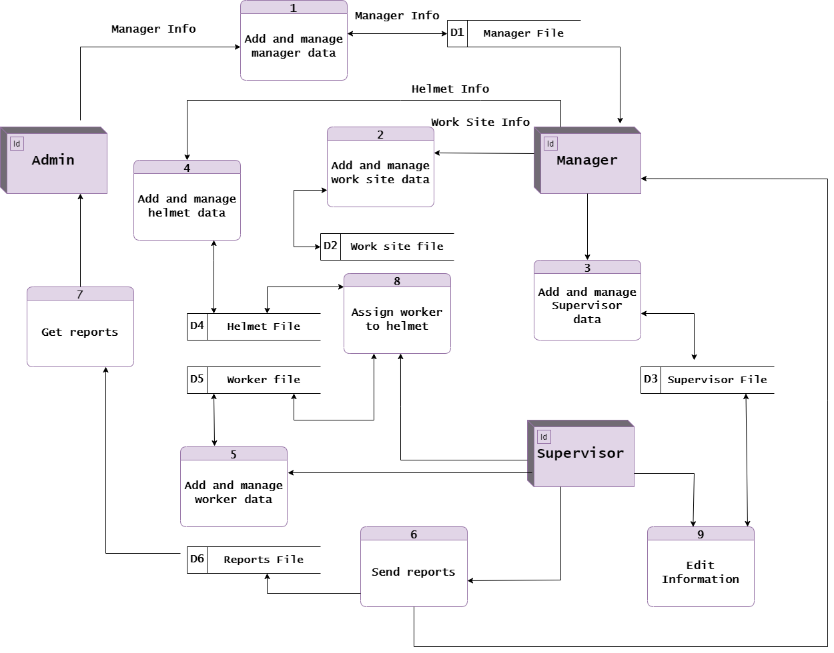
Behavioural diagrams
. Use case Diagram
. DFD Diagram

Slide 16
Why us
- The ideas on the market do not have many of the features found in our helmet
- Most of the existing ideas are directed at cyclists to protect them from road dangers
- There are some existing ideas that focus on the helmet as a basic entity in the idea, while we consider the helmet to be one of the entities present in the project.
- The system in our project includes an electronic website and a phone application to ensure multiple use by supervisors or managers
- We have an alert and notification system and reports management system in Our software to ensure heighest performance and accuracy in the danger situations
- We have an alert and notification system and reports management system in Our software to ensure heighest performance and accuracy in the danger situations

Slide 17
Our progress
100%
(UI / UX) .
45%
Documentation .
100%
Making Diagrams.
100%
Designing the database .
50%
Mobile Application .
100%
Interfaces of website (front-end) .

Slide 18


